Slide 1
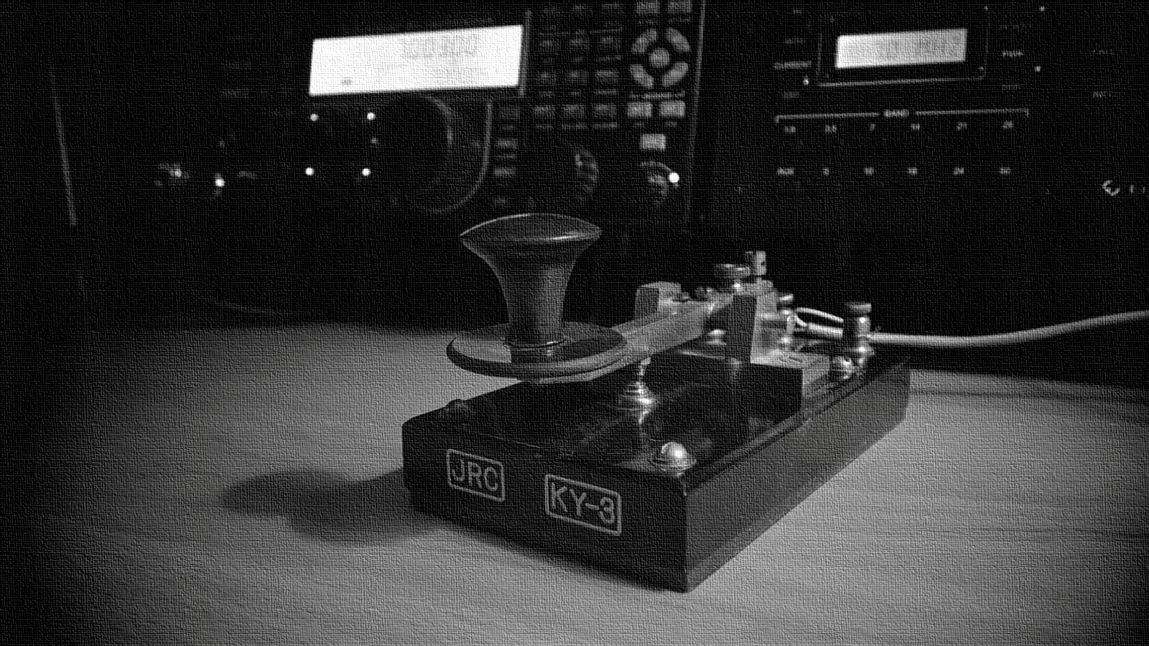
Introduction to Digital Voice Modes and DMR Primer

Slide 2
DISCLAIMER
I am not an expert
I can answer some of the how's and whys
We will discussed general information about digital voice mode and DMR
Not a product endorser or model

Slide 3
OBJECTIVES
TO be able to understand about the standard behind DMR
TO be able to differentiate between digital voice modes
TO enable user to make educated decisions when choosing or trying this systems
TO be able to understand the pros and cons of DMR
TO be ware of common myths that relate to DMR or Digital Voice Modes in general

Slide 4
TERMINOLOGIES
CODEC is software or device that enables faster transmissions and decompresses received data
AMBE or Advanced Multi-Band Excitation is a proprietary technology owned by Digital Voice Systems, Inc. and used on most digital voice radio
TRUNKING is the use of several repeaters, on different frequencies in the same band, operating together under computer control

Slide 5
TERMINOLOGIES
PROPRIETARY is a legal term for ownership
12.5 kHz is a bandwidth spacing is a.k.a. Narrowband
BITSTREAM is a stream of data in binary form

Slide 6
Introduction to Digital Voice Modes

Slide 7
WHAT IS A DIGITAL VOICE MODE?
Its a new technique built around analog to digital converters and codecs that sample a voice signal, compress it, and transmit it as a bit stream
Like other digital media, digital voice offers interference free communications if the radio signal is strong enough to overcome the general noise and interference level

Slide 8
OVERVIEW ON DIGITAL AMATEUR RADIO
D-STAR or Digital Smart Technologies for Amateur Radio
System Fusion
DMR or Digital Amateur Radio

Slide 9

Its an open standard digital communication protocol established by the Japan Amateur Radio League (JARL).
Design for the Amateur Radio Service
ICOM is the only equipment manufacturer making D-STAR gear.

Slide 10

Utilizes C4FM 4-level FSK Technology to transmit digital voice and data over the Amateur radio bands.
Yaesu’s proprietary technology thus making them the sole manufacturer of Fusion radio.

Slide 11
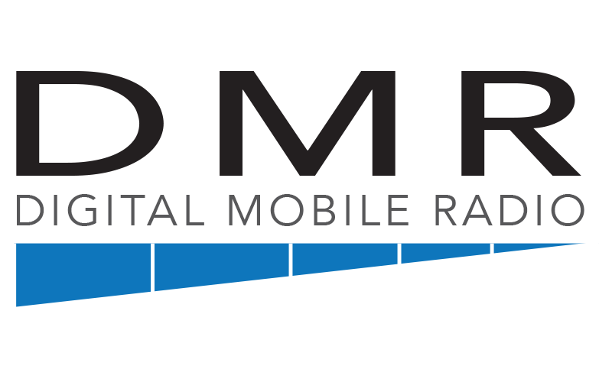
WILL BE DISCUSSED ON NEXT TOPIC

Slide 12
TECH SPEC COMPARISON
 | D-STAR | DMR | Fusion
Vocoder (see note) | AMBE+ | AMBE+2 | AMBE+2
Forward Error Corr. | Voice Only | Voice Only | Voice Only
Modulation | GMSK | 4FSK | C4FM
Multiplex Method | FDMA | TDMA | FDMA
Transmission Rate | 4.8 kbps | 4.8 kbps x 2 | 9.6 kbps
Bandwidth | 6.25 kHz | 12.5 kHz | 12.5 kHz
Channels supported | 1 | 2 | 1
Standard Developer | JARL | ETSI | Yaesu
GMSK Gaussian Minimum Shift Keying
4FSK 4-level Frequency Shift C4FM Continuous 4-level Frequency Modulation FDMA Frequency Division Multiple Access TDMA Time Division Multiple Access

Slide 13
Q & A

Slide 14
Digital Mobile Radio PRIMER

Slide 15
WHAT IS DMR?
Stands for Digital Mobile Radio
Its an international digital radio standard created by the European Telecommunications Standards Institute (ETSI)

Slide 16
WHY WAS IT CREATED?
More than a decade ago, vendors and users of radio systems realized that the existing analog trunking standards required updates.
Improved voice quality
Improved functionality such as Location information
Improved security (i.e. Authentication and Encryption)
Improved channel efficiency (2 slot TDMA)

Slide 17
THE BAD, THE GOOD AND THE UGLY
ETSI DMR Standard defines three different tiers
Tier I
Tier II
Tier III

Slide 18
THE BAD, TIER I
Unlicensed
Works in Simplex only and on public frequencies
Best for individuals, recreation, small retail, or other situations that do not require wide area coverage

Slide 19
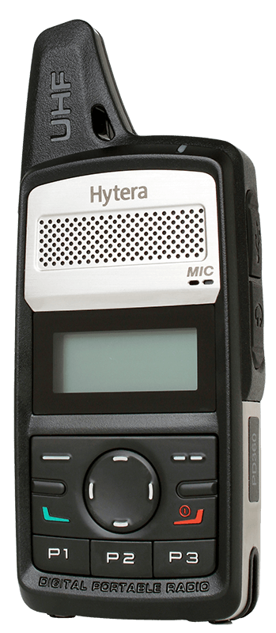
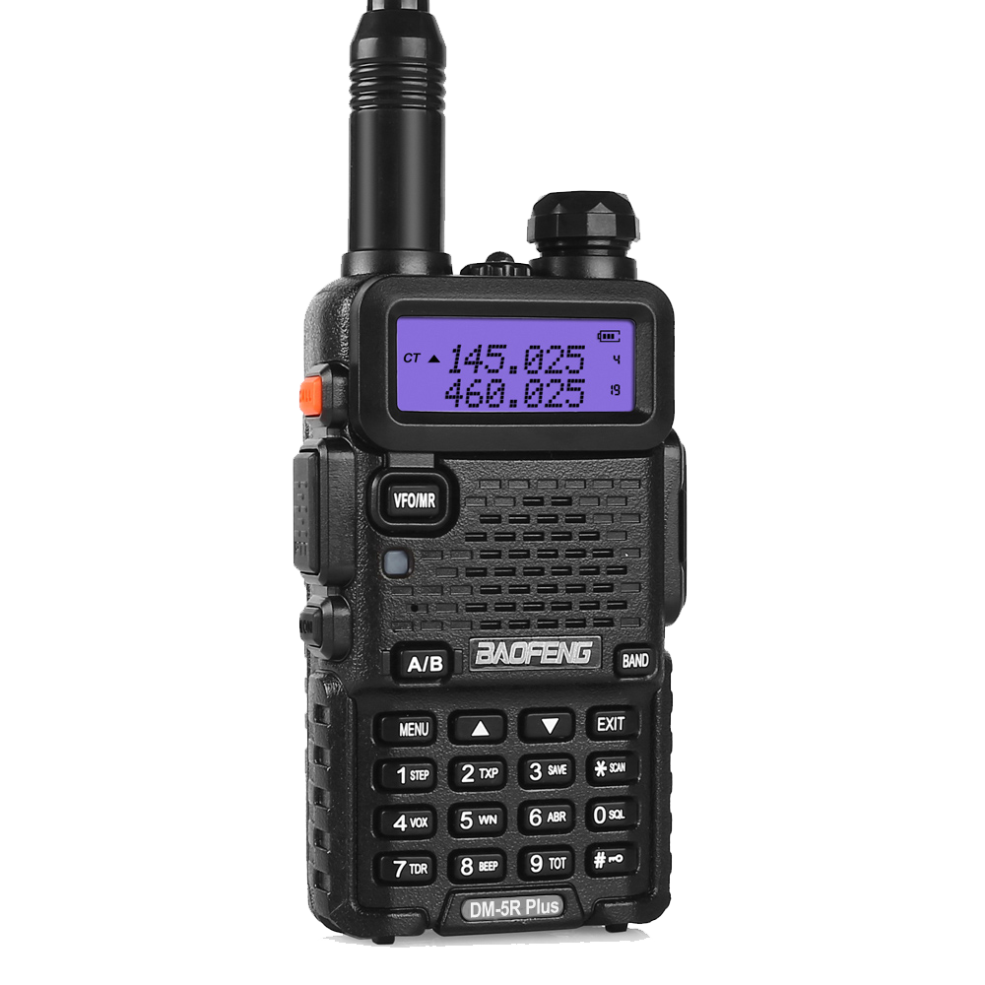

Slide 20
THE GOOD, TIER II
Licensed/Conventional
Aimed to be a direct replacement for the analog conventional radio system.
Systems operate under individual licenses working in Direct Mode (unit-to-unit) or using a Base Station (BS) for repeating.

Slide 21
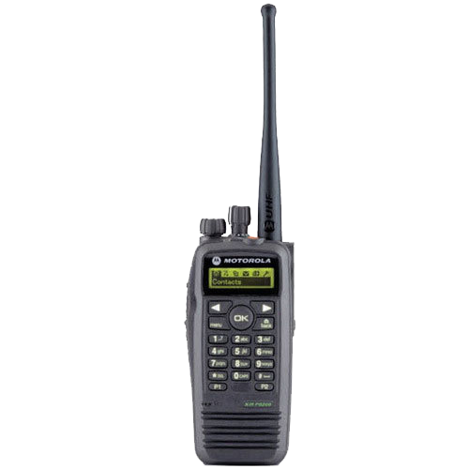
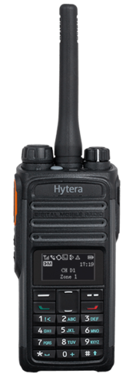
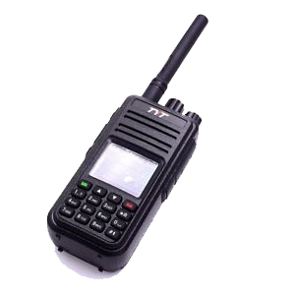

Slide 22
THE UGLY, TIER III
Tier II with trunked support
Operate under individual licenses with a controller function that automatically regulates the communications.
Supports packet data services in a variety of formats, including support for IPv4 and IPv6.
Ideal for organizations looking to migrate from analog trunked radio systems or who want the full benefits of managed trunking, voice and data solution.

Slide 23
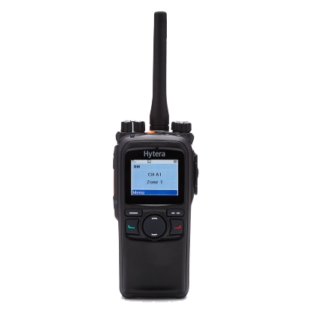
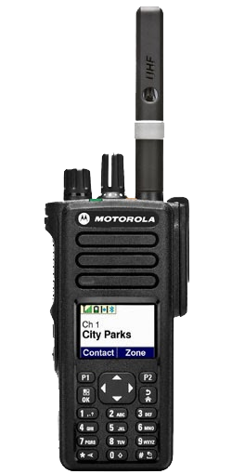

Slide 24
SO HOW DOES DMR WORKS?
DMR standard specifies the use of TDMA which stands for Time Division Multiple Access.
TDMA provides two logical channels and each 12.5-kilohertz channel space. This provides a useful doubling of capacity within the same analog channel space.

Slide 25
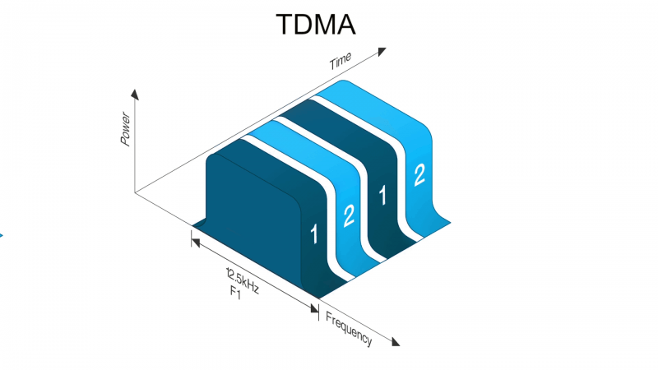

Slide 26
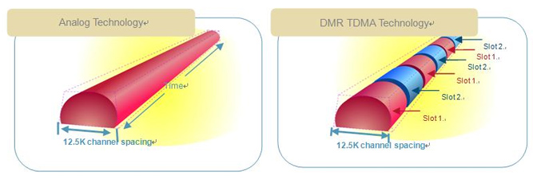
ANALOG VS DMR TDMA
1 voice for each 12.5kHz channel
A single repeater for each channel
Divides existing channel into two timeslots
Single repeater does work of two repeaters

Slide 27
BENEFITS OF DMR
Its an ‘open’ standard and is not proprietary to a single manufacturer. This means that competition is possible between manufacturers, not only when a new system is purchased, but over the lifetime of the system. So, if you need to purchase new subscriber units there will always be multiple options and competitive pricing.
Juan Caser, DW7LFU

Slide 28
BENEFITS OF DMR
Digital Audio Quality. For the end user, one of the key benefits of DMR digital radio technology is the improvement in audio quality over analog.

Slide 29
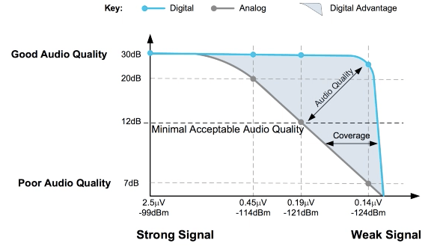

Slide 30
BENEFITS OF DMR
Data applications. Not only is DMR capable of transmitting voice, but the end-to-end digital nature of DMR enables data applications.
Text messaging/SMS
GPS
SCADA, Supervisory Control and Data Acquisition
Telemetry
Transmission of IP data over the air

Slide 31
BENEFITS OF DMR
DMR is a TDMA technology which offers the principle benefit of two simultaneous and independent talk paths in one single 12.5 KHz channel.

Slide 32
BENEFITS OF DMR
DMR is designed for an easy migration from analog to digital by making it fit into the existing 12.5 kHz narrowband FM channels used by legacy analog systems.
As DMR uses very simple transmitters, similar to those found in analog systems, the portables and mobiles can be operated in dual mode, analog or digital mode. This makes the migration path much simpler.

Slide 33
QUESTION
IS DMR A DIGITAL AMATEUR RADIO?

Slide 34
ANSWER
NO
DMR uses a standard that is catered toward commercial use.
BUT its also YES
Ham was able to adopt it and make it part of amateur radio.

Slide 35
HOW TO GET STARTED?
Get a Tier 2 capable DMR radio
Register for a DMR ID at https://register.ham-digital.org/
Once you get your DMR ID you then update you radio with your new DMR ID and add contacts to its memory.
Get a HOTSPOT (OPTIONAL)

Slide 36
Q & A

Slide 37
A Quickie on BrandMeister

Slide 38
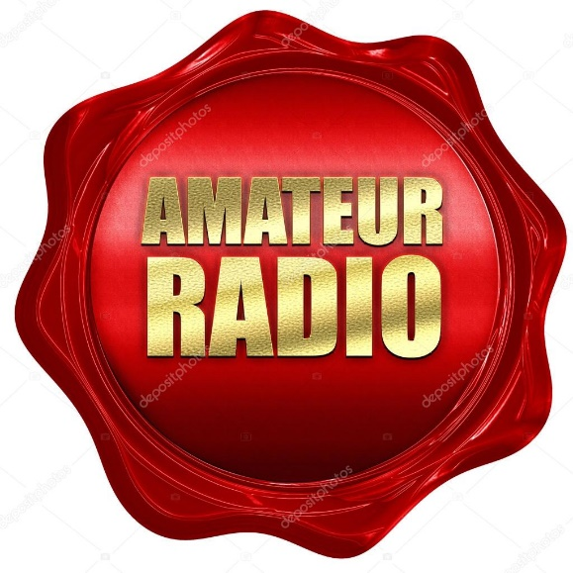
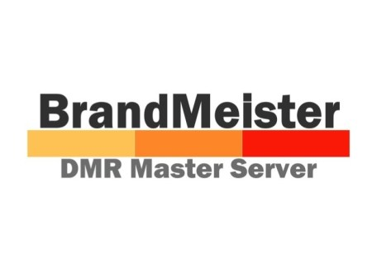

Slide 39
BRANDMEISTER NETWORK?
The Brandmeister Network was born from several worldwide hams and software engineers who joined together to create a digital repeater network consisting of master servers and peer repeaters all over the world.
The network has over 1300 repeaters and more than 3000 hotspots across the globe and it’s growing every day!

Slide 40
BRANDMEISTER NETWORK?
Brandmeister is tailored to the Motorola TRBO technology and allows for DMR repeaters to connect worldwide via the internet and link systems together by utilizing organized Talkgroups.

Slide 41
BRANDMEISTER NETWORK?
The Brandmeister Network offers several neat features for amateur radio enthusiasts to take advantage of.
Private Call
Talkgroups
APRS, Automatic Packet Reporting System
SMS Text Messaging
D-Star Gateway
Echolink Gateway

Slide 42
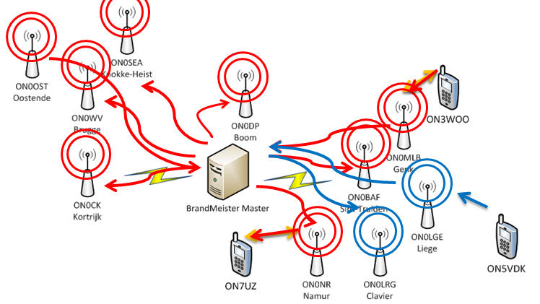
BRANDMEISTER NETWORK

Slide 43
SO HOW CAN I CONNECT TO BRANDMEISTER?

Slide 44
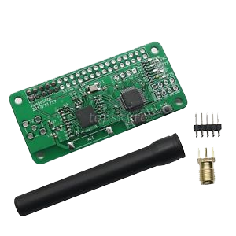
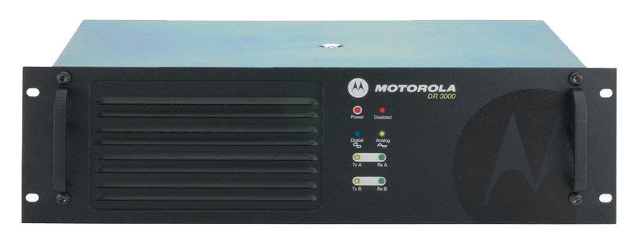
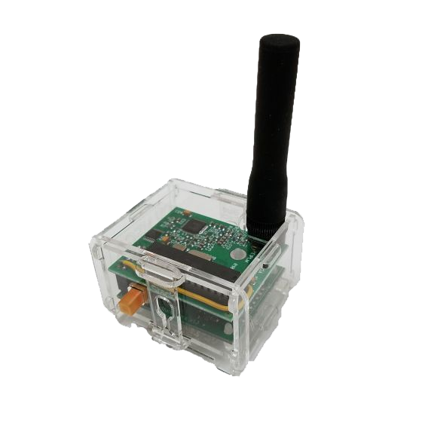
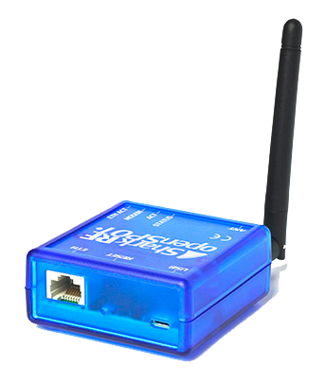

Slide 45
NOT-ANOTHER-DISCLAIMER
We will not include discussions on dedicated repeater
We will focus only on hotspot

Slide 46
SO WHAT IS REALLY A HOTSPOT?
Its device used in Digital Voice to connect to other internet linked repeater around the world through Brandmeister Network master server.
It’s a personal repeater.
Most hotspots is powered by MMDVM or Multi Mode Digital Voice Modem
Its not required but optional only.

Slide 47
SO WHY GET A HOTSPOT?
When you are located on an area where there is no available DMR repeater
When you are traveling but you still want to contact friends at home
When you want flexibility on your digital voice radio by using BrandMeister network

Slide 48
YOU MENTION MMDVM? WHAT IS THAT?

Slide 49
OVERVIEW ON MMDVM
Stands for Multi Mode Digital Voice Modem
It is developed as an Open Source software
Developed by Jonathan Naylor, G4KLX
It initially support D-Star and DMR, with System Fusion, NXDN and P25 followed later

Slide 50
OVERVIEW ON MMDVM
It utilize the power of an ARM processor and a simple analogue interface board
It is aimed at the Arduino Due, Teensy 3.1/3.2 and embed platforms, the only requirement for the hardware is to be ARM Cortex-M3, M4, or M7 based. Raspberry PI runs of ARM CPU
It is widely used on most homebrew and commercial hotspot

Slide 51

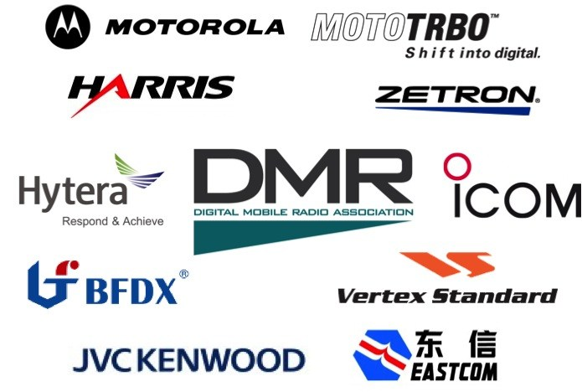

Slide 52
Q & A

Slide 53
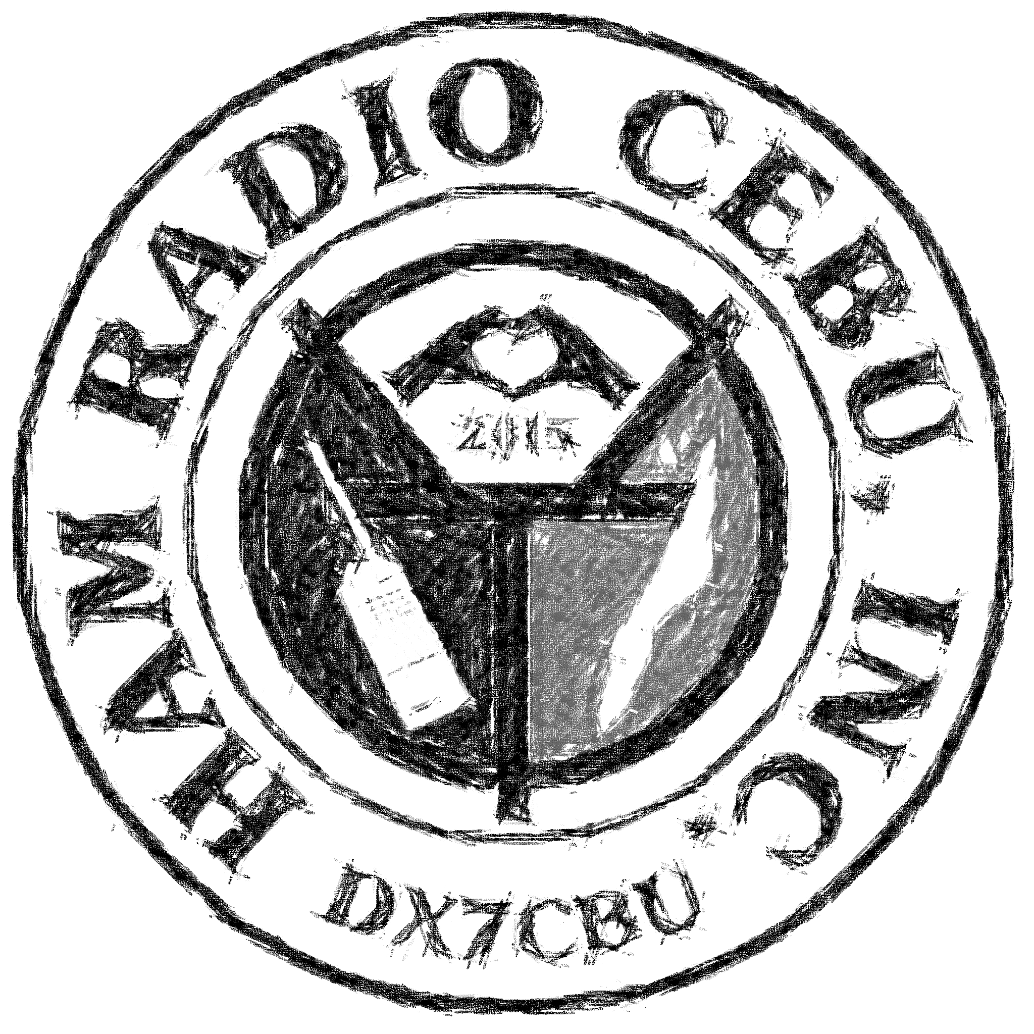
TG 51578
Thank You and 73 DE DW7LFU

